Slide 1
SURVEYING
LECTURE 02
Engr. Syed Saqib Mehboob
Lecturer, CED
University of Engineering & Technology, Taxila

Slide 2
TYPES OF SURVEY
This section is devoted to a brief description of various types of surveys.
Land surveys are the oldest type of survey and have been performed since earliest recorded history.
They are normally plane surveys made for locating property lines, subdividing land into smaller parts, determining land areas, and any other information involving the transfer of land from one owner to another. These surveys are also called property surveys, boundary surveys or cadastral surveys.

Slide 3
TYPES OF SURVEY
Topographic surveys: By topography is meant the shape or configuration of the earth’s surface.
Topographic surveying is the process of determining the positions, both in plan and elevation, of the natural and artificial features of a region, and delineating them by means of conventional symbols upon a map called a topographic map.
The distinguishing feature of a topographic survey is the location and sketching of contours. A topographic map shows, hills and valleys, streams, rivers, lakes, trees, etc.
Also the artificial features, such as roads, railways, canals, houses etc

Slide 4
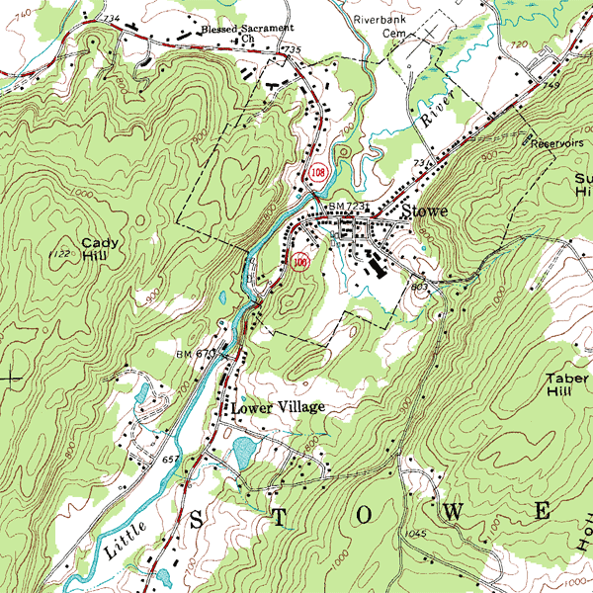
Topographic Survey

Slide 5
TYPES OF SURVEY
Route surveys: It involve the determination of the location of natural and artificial objects along a proposed route for a highway, railroad, canal, pipeline, power line, or other utility. They may further involve the location or staking out the facility and the calculation of earthwork quantities.
City or Municipal surveys: are made within a municipality for the purpose of laying out streets, planning sewer systems, preparing maps and so on. When the term is used, it usually brings to minds topographic surveys in or near a city for the purpose of planning urban expansions or improvements.

Slide 6
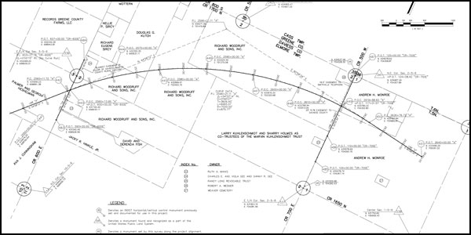
Route surveys

Slide 7
TYPES OF SURVEY
Construction surveys are made for purpose of locating structures and providing required elevation points during their construction. They are needed to control every type of construction project.
Hydrographic surveys pertain to lakes, streams and other bodies of water. Shorelines are chartered, shapes of areas beneath water surfaces are determined, water flow of streams is estimated, and other information needed relative to navigation, flood control and development of water resources is obtained.
These surveys are usually made by a governmental agency.

Slide 8
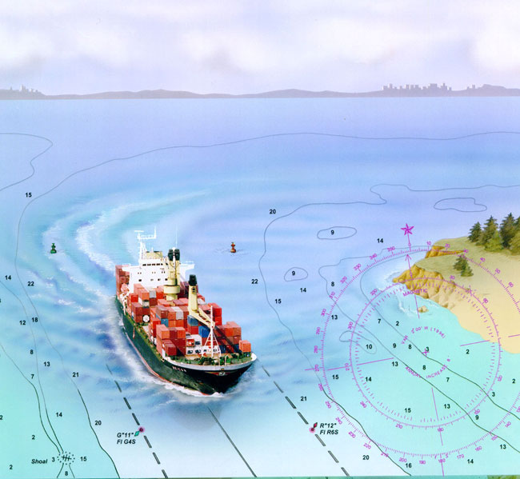
Hydrographic survey

Slide 9
TYPES OF SURVEY
Marine surveys are related to hydrographic surveys, but they are thought to cover a broader area. They include the science of navigation, marine features and water depth etc on hydrographic maps and charts.
Mine surveys are made to obtain the relative positions and elevations of underground shafts, geological formations, and so on.

Slide 10
TYPES OF SURVEY
Forestry and Geological surveys are much more common than the average layperson realizes. Foresters use surveying for boundary, locations, timber cruising, topography, and so on. Similarly, surveying has much application in the preparation of geological maps.
Photogrammetric surveys are those in which photographs (generally aerial) are used in conjunction with limited ground surveys (used to establish or locate certain control points visible from the air).

Slide 11
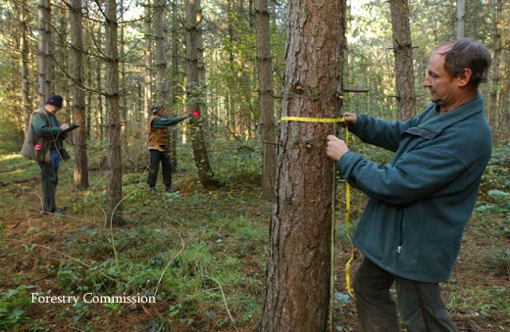
Forestry Survey

Slide 12
TYPES OF SURVEY
As Built survey is similar to preliminary survey with a difference of that is has been constructed to provide a final record of the construction and to check the construction has proceeded according to the design plan.
Control surveys are reference surveys. For a particular control survey a number of points are established and their horizontal and vertical positions very accurately determined.
These points are called Bench Marks.

Slide 13
Accuracy and Precision
Accuracy:
It is the relationship between the value of a measurement and the “true” or theoretically correct value of the dimension being measured.
Precision:
It describes the refinement of the measuring process and the ability to repeat the same measurement with consistently small variation in different conditions.

Slide 14
Accuracy and Precision
High Accuracy
Low Accuracy
Low Precision
High Precision

