Slide 1
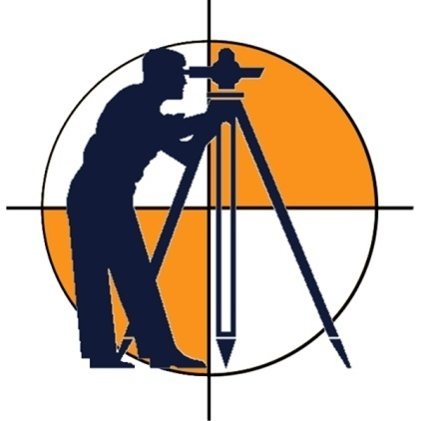
SURVEYING
LECTURE 01
Engr. Syed Saqib Mehboob
Lecturer, CED

Slide 2
SURVEYING
Surveying is the art of making measurements of relative positions of natural and man-made features on or near the surface of earth and then plotting them to some suitable scale to form a map.

Slide 3
SURVEYING
ART
SCIENCE
The accuracy and thus reliability of the survey depends not only on the field expertise but also on the surveyor’s understanding of the scientific principles.

Slide 4
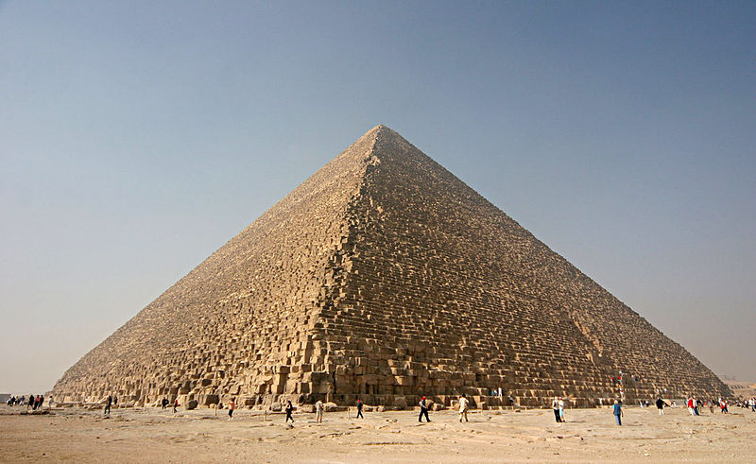
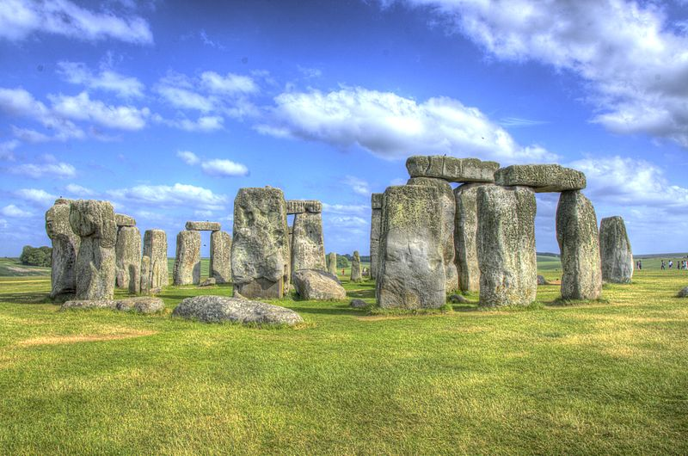
HISTORY
A brief history:
In ancient Egypt, when the Nile River overflowed its banks and washed out farm boundaries, boundaries were re-established by a rope stretcher, or surveyor, through the application of simple geometry.
The nearly perfect squareness and north-south orientation of the , built 2700 BC, affirm the Egyptians' command of surveying.
A recent reassessment of (2500 BC) suggests that the monument was set out by prehistoric surveyors using peg and rope geometry.
Great Pyramid of Giza
Stonehenge

Slide 5
OBJECTIVE
The main objective of surveying is to form the map of the site.
This map should provide following information:
Distance between different features on the site.
Direction of the features.
Difference of level between different features.

Slide 6
OBJECTIVE
It also involves marking of lines and grades needed for the construction of building, roads, dams and other engineering structures.
Surveying has many industrial applications as well like; setting equipment, laying out assembly lines, and so on.

Slide 7
CLASSIFICATION
Plane Survey
Geodetic Survey
ln plane survey curvature of earth is not taken into account.
In plane surveying the earth is considered to be a flat surface and north-south lines are assumed to be parallel.
Calculations for a plane surface are relatively simple, since the surveyor is able to use plane geometry and plane trigonometry.

Slide 8
Plane Survey
Plane surveys, however, are made on such small areas that the effect of curvature may be neglected. e.g., American surveyors put the limit at 250 km² for treating the survey as plane.
In large scale mapping, adjustments are made for the curvature of earth. E.g., For highways and Railroads, corrections applied at regular interval of 1 mile to correct for the earth curvature.

Slide 9
Plane Survey
Most of surveys are sufficiently accurate for all but the largest areas. Survey of farms, subdivisions, buildings, highways, railroads, and in fact most constructed works are plane surveys.

Slide 10
Plane Survey
RIGHT TO KNOW…
It can also be shown that an arc along the earth’s curved surface of 11.5 miles in length is only approximately 0.5 feet longer than the plane or chord distance between its ends.

Slide 11
Geodetic Survey
In geodetic surveying, also called Trigonometric Surveying. It is necessary to take into account the curvature of the earth. Since shape of the earth is spheroidal, the line connecting any two points on the surface of the earth is curved or an arc of a grant circle.
Traditional geodetic survey is of great magnitude like;
National Boundaries

Slide 12
Geodetic Survey
Geodetic surveys are those that are adjusted for the curved shape of the Earth’s surface. (Info: The earth is an oblate spheroid whose radius at the Equator is about 13.5 miles greater than its polar radius.)
Since they allow for earth’s curvature, geodetic surveys can be applied to both small and large areas.

Slide 13
Basic Principle of Surveying
The ruling principle of surveying is to work from the whole to a part and not from part to whole.
First, control points are established in the area to be surveyed and this can be done through a network of triangles or traversing.
Control points for the “primary network" are provided with the help of instruments of highest precision and by adopting well-established methods of observation.
The underlying idea is to minimize the accumulation of error and to localize the error. If the survey is made to expand outward from the central points, the minor errors will become so magnified as to become uncontrollable at the end.

